Slide 1
Topics in Multi-Agent RL
Neeloy Chakraborty

Slide 2
Agenda
Introduction
Multi-Agent Reinforcement Learning
Learning to Teach in Cooperative MARL
Encouraging Exploration
MARL Applied to a Cool Heist Game Environment

Slide 3
Agenda
Introduction
Multi-Agent Reinforcement Learning
Learning to Teach in Cooperative MARL
Encouraging Exploration
MARL Applied to a Cool Heist Game Environment

Slide 4
A little bit about myself
Rising senior studying computer engineering
Currently interning at Qualcomm for the summer
Originally from Pittsburgh, PA
Favorites
Color: Navy Blue
Food: Paneer
Started playing the violin in the third grade

Slide 5
Over this summer, I was interested in learning more about…
Human-Robot Collaboration
Modelling Trust in Robots
MARL
Encouraging Exploration

Slide 6
Agenda
Introduction
Multi-Agent Reinforcement Learning
Learning to Teach in Cooperative MARL
Encouraging Exploration
MARL Applied to a Cool Heist Game Environment
Buşoniu L., Babuška R., De Schutter B. (2010) Multi-agent Reinforcement Learning: An Overview. In: Srinivasan D., Jain L.C. (eds) Innovations in Multi-Agent Systems and Applications - 1. Studies in Computational Intelligence, vol 310. Springer, Berlin, Heidelberg. https://doi.org/10.1007/978-3-642-14435-6_7

Slide 7
What is a MARL problem?
https://link.springer.com/chapter/10.1007/978-3-642-14435-6_7
We can generalize the single-agent RL problem for multi-agents through a Stochastic Game
n – # of agents
X – set of states
U = {U₁…U_{n}} – joint action space of all agents
ƒ – state transition probabilities
ρ₁...ρ_{n} – reward functions of agents 1…n
h – joint policy of all agents
r_{i,k+1} – reward of agent i from timestep k
*Return of Agent i w/ joint policy h
*Q-func of Agent i w/ joint policy h
*Rewards of agents depend on the joint action, so returns and q-vals depend on joint policy

Slide 8
Types of MARL Game Settings
Fully-Cooperative
Fully-Competitive
Mixed
Static (Stateless) Game
Stage Game

Slide 9
Pros and Cons to Consider
https://link.springer.com/chapter/10.1007/978-3-642-14435-6_7
Benefits | Challenges
Experience sharing makes training faster, and train policies with better performance | Exponential complexity of state and action space, as well as computation needed
When an agent fails, others can help | Hard to specify goal because agents’ rewards are correlated
Agents can exploit the decentralized nature of a global task, and speed up training | Nonstationary problem – Models of other agents must adapt as they learn more
 | Agents must coordinate with (or at least consider) others to get max reward
 | Must balance exploration amount in order to learn about other agents, but also not destabilize the learning task

Slide 10
Pros and Cons to Consider
https://link.springer.com/chapter/10.1007/978-3-642-14435-6_7
Benefits | Challenges
Experience sharing makes training faster, and train policies with better performance | Exponential complexity of state and action space, as well as computation needed
When an agent fails, others can help | Hard to specify goal because agents’ rewards are correlated
Agents can exploit the decentralized nature of a global task, and speed up training | Nonstationary problem – Models of other agents must adapt as they learn more
 | Agents must coordinate with (or at least consider) others to get max reward
 | Must balance exploration amount in order to learn about other agents, but also not destabilize the learning task

Slide 11
Pros and Cons to Consider
https://link.springer.com/chapter/10.1007/978-3-642-14435-6_7
Benefits | Challenges
Experience sharing makes training faster, and train policies with better performance | Exponential complexity of state and action space, as well as computation needed
When an agent fails, others can help | Hard to specify goal because agents’ rewards are correlated
Agents can exploit the decentralized nature of a global task, and speed up training | Nonstationary problem – Models of other agents must adapt as they learn more
 | Agents must coordinate with (or at least consider) others to get max reward
 | Must balance exploration amount in order to learn about other agents, but also not destabilize the learning task

Slide 12
Pros and Cons to Consider
https://link.springer.com/chapter/10.1007/978-3-642-14435-6_7
Benefits | Challenges
Experience sharing makes training faster, and train policies with better performance | Exponential complexity of state and action space, as well as computation needed
When an agent fails, others can help | Hard to specify goal because agents’ rewards are correlated
Agents can exploit the decentralized nature of a global task, and speed up training | Nonstationary problem – Models of other agents must adapt as they learn more
 | Agents must coordinate with (or at least consider) others to get max reward
 | Must balance exploration amount in order to learn about other agents, but also not destabilize the learning task

Slide 13
Pros and Cons to Consider
https://link.springer.com/chapter/10.1007/978-3-642-14435-6_7
Benefits | Challenges
Experience sharing makes training faster, and train policies with better performance | Exponential complexity of state and action space, as well as computation needed
When an agent fails, others can help | Hard to specify goal because agents’ rewards are correlated
Agents can exploit the decentralized nature of a global task, and speed up training | Nonstationary problem – Models of other agents must adapt as they learn more
 | Agents must coordinate with (or at least consider) others to get max reward
 | Must balance exploration amount in order to learn about other agents, but also not destabilize the learning task

Slide 14
Pros and Cons to Consider
https://link.springer.com/chapter/10.1007/978-3-642-14435-6_7
Benefits | Challenges
Experience sharing makes training faster, and train policies with better performance | Exponential complexity of state and action space, as well as computation needed
When an agent fails, others can help | Hard to specify goal because agents’ rewards are correlated and maximized dependently
Agents can exploit the decentralized nature of a global task, and speed up training | Nonstationary problem – Models of other agents must adapt as they learn more
 | Agents must coordinate with (or at least consider) others to get max reward
 | Must balance exploration amount in order to learn about other agents, but also not destabilize the learning task

Slide 15
Pros and Cons to Consider
https://link.springer.com/chapter/10.1007/978-3-642-14435-6_7
Benefits | Challenges
Experience sharing makes training faster, and train policies with better performance | Exponential complexity of state and action space, as well as computation needed
When an agent fails, others can help | Hard to specify goal because agents’ rewards are correlated and maximized dependently
Agents can exploit the decentralized nature of a global task, and speed up training | Nonstationary problem – Models of other agents must adapt as they learn more
 | Agents must coordinate with (or at least consider) others to get max reward
 | Must balance exploration amount in order to learn about other agents, but also not destabilize the learning task

Slide 16
Pros and Cons to Consider
https://link.springer.com/chapter/10.1007/978-3-642-14435-6_7
Benefits | Challenges
Experience sharing makes training faster, and train policies with better performance | Exponential complexity of state and action space, as well as computation needed
When an agent fails, others can help | Hard to specify goal because agents’ rewards are correlated and maximized dependently
Agents can exploit the decentralized nature of a global task, and speed up training | Nonstationary problem – Models of other agents must adapt as they learn more
 | Agents must coordinate with (or at least consider) others to get max reward
 | Must balance exploration amount in order to learn about other agents, but also not destabilize the learning task

Slide 17
Pros and Cons to Consider
https://link.springer.com/chapter/10.1007/978-3-642-14435-6_7
Benefits | Challenges
Experience sharing makes training faster, and train policies with better performance | Exponential complexity of state and action space, as well as computation needed
When an agent fails, others can help | Hard to specify goal because agents’ rewards are correlated and maximized dependently
Agents can exploit the decentralized nature of a global task, and speed up training | Nonstationary problem – Models of other agents must adapt as they learn more
 | Agents must coordinate with (or at least consider) others to get max reward
 | Must balance exploration amount in order to learn about other agents, but also not destabilize the learning task

Slide 18
Pros and Cons to Consider
https://link.springer.com/chapter/10.1007/978-3-642-14435-6_7
Benefits | Challenges
Experience sharing makes training faster, and train policies with better performance | Exponential complexity of state and action space, as well as computation needed
When an agent fails, others can help | Hard to specify goal because agents’ rewards are correlated and maximized dependently
Agents can exploit the decentralized nature of a global task, and speed up training | Nonstationary problem – Models of other agents must adapt as they learn more
 | Agents must coordinate with (or at least consider) others to get max reward
 | Must balance exploration amount in order to learn about other agents, but also not destabilize the learning task
CHALLENGE ACCEPTED!

Slide 19
Fully Cooperative Tasks
In a fully cooperative task, all agents the same reward function: ρ₁ = ρ₂ = … = ρ_{n}
The final goal is also the same: to maximize the common cumulative return R^{h}
But some other things we also need to consider include:
How to make agents want to trade information and learn with each other
Encourage exploration in games that have sparse rewards

Slide 20
Agenda
Introduction
Multi-Agent Reinforcement Learning
Learning to Teach in Cooperative MARL
Encouraging Exploration
MARL Applied to a Cool Heist Game Environment
Learning to Teach in Cooperative Multiagent Reinforcement Learning: arXiv:1805.07830

Slide 21
Collaborative agents should to be able to:
Know when to ask for help from others
Learn how and what to advise others if asked
Consider how to apply advice to current state
Estimate the learning progress of others

Slide 22
Teaching in Cooperative MARL
https://arxiv.org/abs/1805.07830
Setting: Agents i & j collaborate in a Dec-POMDP
Problems to Learn:
Task-level learning problem P_{Task}
Learn a policy to execute actions in environment
Advising-level problem P_{Advise}
Learn a policy to ask for help when needed
Learn a policy to teach others when needed
Overall: P_{Advise} policies will be used to accelerate the learning and effectiveness of P_{Task}’s policy π by allowing agents to teach each other along the way
Agent
P_{Task}
P_{Advise}
π
π_{student}
π_{Teacher}

Slide 23
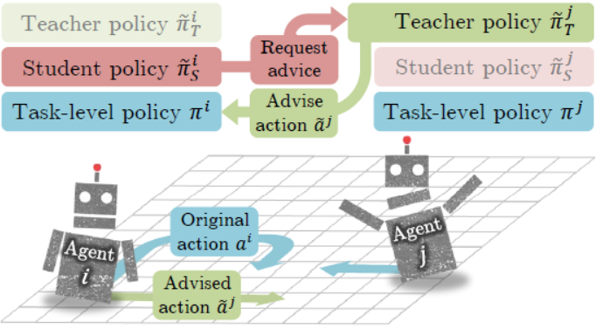
https://arxiv.org/abs/1805.07830

Slide 24
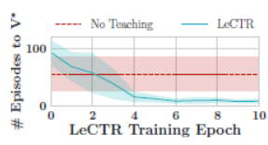
Experimental Procedures and Observations
https://arxiv.org/abs/1805.07830
Games were in a discrete action space
Advising Level Policies were trained with Actor-Critic
Advising Level Policies π_{student} & π_{Teacher} are actors
Centralized Action-Value function is critic
Task Level Policy π trained with tabular Q-Learning
Considerations:
Roles of student & teacher can flip every time step
Supports teaching of heterogeneous teammates
Allows communication cost model
Converges to optimal value function faster than older methods
The most optimal action is not always advised, allowing for exploration
Extension: I would like to further use the Advising Level policies in testing, rather than just training

Slide 25
Agenda
Introduction
Multi-Agent Reinforcement Learning
Learning to Teach in Cooperative MARL
Encouraging Exploration
MARL Applied to a Cool Heist Game Environment
Curiosity-driven Exploration by Self-supervised Prediction: arXiv:1705.05363

Slide 26
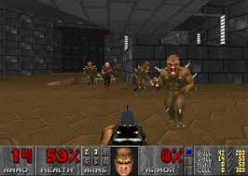
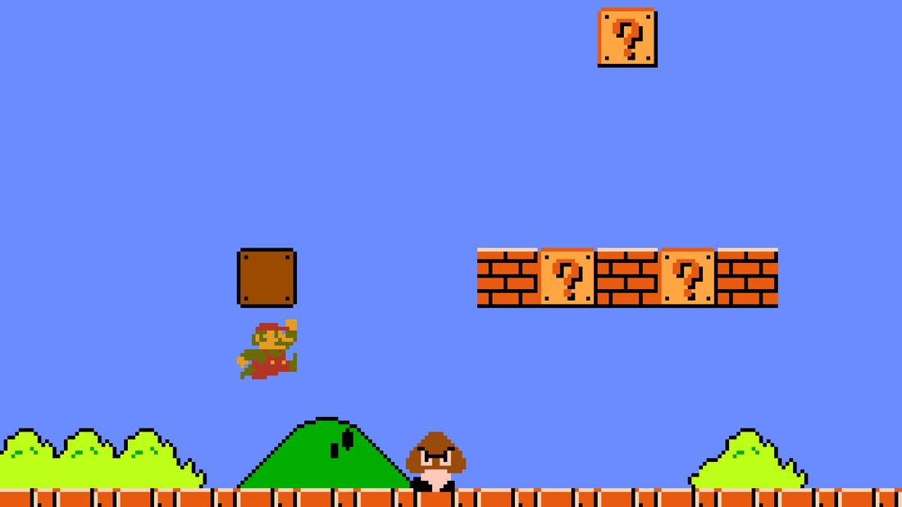
Some games are really hard to learn how to play 😐
https://store.steampowered.com/app/2270/Wolfenstein_3D/
https://arxiv.org/pdf/1809.03470.pdf
https://www.businessinsider.com/256-secret-levels-in-super-mario-bros-2015-9

Slide 27
The Importance of Intrinsic Rewards
https://pathak22.github.io/noreward-rl/resources/icml17.pdf
When extrinsic rewards are sparse and delayed, it is important for the agent to have an internal reward signal encouraging them to explore
Problem Subsystems
Help agent solve tasks with sparse rewards
Help agent explore environment in the quest for new knowledge
Help agent to learn skills for future user
Reward r_{t} = r_{t}^{i} + r_{t}^{e}
r_{t}^{i} is intrinsic signal
r_{t}^{e} is external from env
Policy π maximizes r_{t}
Curiosity Signal

Slide 28
Considerations
https://pathak22.github.io/noreward-rl/resources/icml17.pdf
Past intrinsic rewards could be classified under:
Encourage agent to explore new states
Stochastic, noisy environments can make it seem like all states are novel
Encourage agent to act to reduce uncertainty in prediction of future consequences
Build a model to predict next state given current state and action
Problem: Both models are difficult to scale-up and are prone to not being able to generalize
New Approach: Let r_{t}^{i} be the error between two learned feature representations of next state

Slide 29
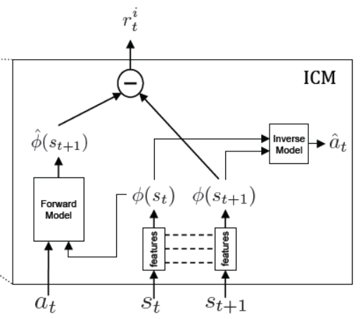
Approach Consists of Two Networks:
https://pathak22.github.io/noreward-rl/resources/icml17.pdf
Inverse Dynamics Model
Given: a_{t}, s_{t}, and s_{t+1}
Sub-Network 1 converts s_{t}, and s_{t+1} into Φ (s_{t}) and Φ (s_{t+1}) features
Sub-Network 2 predicts â_{t} that was taken to get from Φ (s_{t}) to Φ (s_{t+1})
Sub-Network 1 learns from the loss between â_{t} and a_{t}
Forward Dynamics Model
Given: a_{t}, Φ (s_{t}), and, Φ (s_{t+1})
Network predicts (s_{t+1})
Network optimizes the loss between Φ (s_{t+1}) and (s_{t+1})
r_{t}^{i} Value
The intrinsic reward is the difference between Φ (s_{t+1}) and (s_{t+1})

Slide 30
Observations
https://pathak22.github.io/noreward-rl/resources/icml17.pdf
Games (Super Mario Bros & VizDoom) were played with different settings
Sparsity of rewards impacted ICM+A3C less than baseline A3C model
Stochastic noise in games did not worsen the output of ICM+A3C
Agents trained with ICM+A3C explored more states than other methods
Agent trained on one level is able to generalize to another level
Overall: In games where there is a delay between action and reward, or just a lack of
rewards, ICM shows the ability to entice agents to explore heavily

Slide 31
Agenda
Introduction
Multi-Agent Reinforcement Learning
Learning to Teach in Cooperative MARL
Encouraging Exploration
MARL Applied to a Cool Heist Game Environment
Leveraging Procedural Generation to Benchmark Reinforcement Learning: arXiv:1912.01588

Slide 32
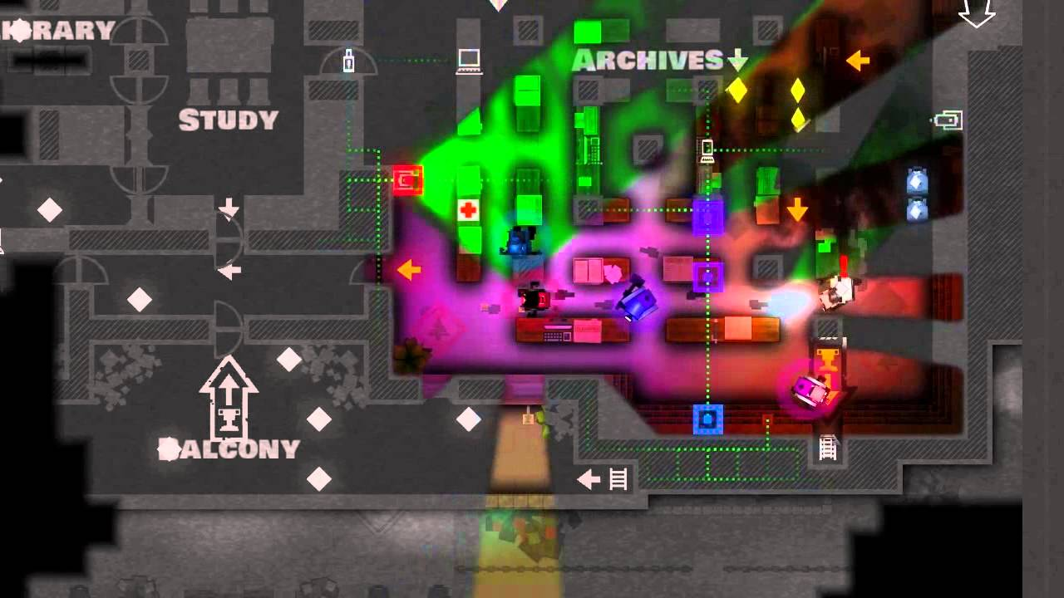
Monaco: What's Yours Is Mine
https://pixelrelated.net/2013/05/10/monaco-whats-yours-is-mine-review-oceans-four/
https://www.youtube.com/watch?v=Gl0RBSAPpDg
Setting: A group of convicts are attempting to escape an environment
Constraints: Each person has a different role, and can only access certain objects
Overall: Everyone needs to coordinate every level to reach the goal together

Slide 33
OpenAI’s Heist Procgen Environment
https://arxiv.org/abs/1912.01588
Setting: A single agent is attempting to get to the diamond
Constraints: Agent must collect colored key before opening doors
Levels: Procgen procedurally generates levels randomly
Overall:
Difficult problem because of lack of rewards
Must be able to generalize because env is random
OpenAI’s baseline in order to generalize:
PPO w/ IMPALA CNN
200M timesteps on 100M different levels
~24 GPU hours ☹
CHALLENGE ACCEPTED!
https://openai.com/blog/procgen-benchmark/

Slide 34
Current State
Network: Baseline IMPALA CNN
3 Convolutional Sequences (CS)
1 CS = 2D Conv -> Max Pooling -> Residual Block -> Residual Block
1 Residual Block = 2x 2D Conv w/ ReLU activations
Overall: 18 layers
Method: PPO w/ Tensorflow backend using OpenAI’s baselines
Training: 25M timesteps on 10M levels on Google Colab for ~6 hours
Problems: Net is too big, and did not run for enough timesteps to generalize

Slide 35
Goals
Modify network
Use fewer residual blocks and convolutional sequences
Add LSTM to end of CNN to push for memory
Retrain with more available levels (100M)
Modify environment:
Modify reward to entice agent to collect keys
Add support for MARL & drive exploration and collaboration

Slide 36
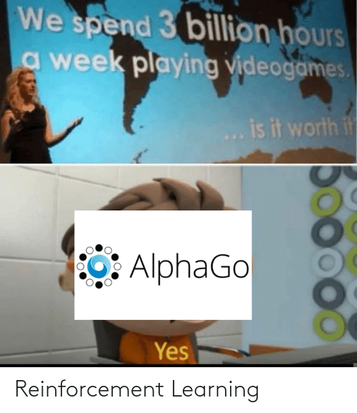
https://me.me/i/reinforcement-learning-ac1b289d0f454935b8bd60b458df07ef

Slide 37
Thank You!

